Slide 1


Oral Communication Skills A
(CELEN069)
Lesson 10.2

Slide 2
Lesson aims and objectives
By the end of this lesson, you should have enhanced your speaking and listening ability through practice.
In addition, you should be better able to … | Intended Learning Outcomes
collaborate with peers in a group discussion | 1.1 1.6 2.4 2.5
recognise main features of the OCSa group discussion marking criteria

Slide 3

Getting started

Slide 4
Getting started
In the Group Discussion Exam, you will receive a score out of 10 for each of the three criteria in the Marking descriptors.
Do you know what the three criteria are?
Task response
Coherence
Development of ideas
Interaction
Interactive behaviours
Delivery
Fluency
Pronunciation & speech features
Language use
What do you think you have to do to get a score of 10 for each one?
Hint: Look on p.2 of the CELEN069 OCSa Group Discussion Descriptors 2024-2025 document
for more information on each criteria.
Notes:
Teacher example: (medical) robot

Slide 5

Language and skills focus
(Marking descriptors)

Slide 6

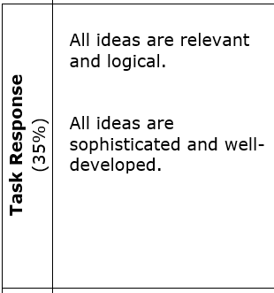
Language and skills focus: Marking descriptors
Make sure ideas are relevant to the topic and task stage.
Use information from the Core Units, readings and self-study materials on Moodle, extra research and your own knowledge to support and develop your ideas.
As a group, complete the task (giving appropriate time to each stage).
*sophisticated = talk in an in-depth and knowledgeable manner

Slide 7
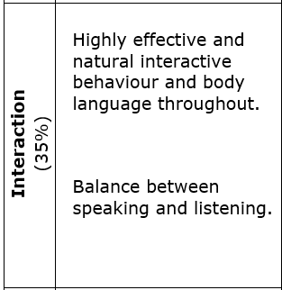
Language and skills focus: Marking descriptors
Listen to the other speakers and build on their ideas.
Encourage others to contribute (if necessary).
Use body language effectively.
Speak for an appropriate length of time (not dominating or too quiet).

Slide 8
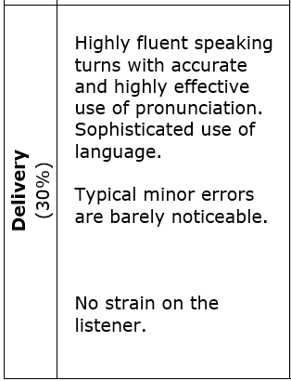
Language and skills focus: Marking descriptors
Speak clearly and loudly enough.
Use appropriate pacing and pausing.
Use appropriate stress and intonation.
Use appropriate grammar and vocabulary.
Pronounce key words accurately.

Slide 9
Language and skills focus: Marking descriptors
Discuss in groups. What can you do to prepare for the exam and improve your score in each of the criteria?
Task response
Coherence
Development of ideas
Interaction
Interactive behaviours
Delivery
Fluency
Pronunciation & speech features
Language use
Notes:
Teacher example: (medical) robot

Slide 10
Language and skills focus: Marking descriptors
Suggestions: | This helps with:
Review your lecture notes and re-watch the Core Unit lectures (both A and B). | Task response Delivery
Identify key vocabulary and practise the pronunciation using the voice recognition software on your phone. | Delivery
Use the suggested readings and the self-study materials available on Moodle or do your own research to increase your knowledge about the Core Unit topics. | Task response
Meet with your peers outside of class and practise having group discussions. | Task response Interaction Delivery
Create possible exam prompts.
Review the materials from the group discussion lessons (1.2, 3.2, 4.2, 5.2, 6.2, 9.2, 10.2).

Slide 11
Language and skills focus
(Interaction - review)

Slide 12
Language and skills focus: Interaction - review
Now, we’re going to focus on reviewing interaction.
Task response
Coherence
Development of ideas
Interaction
Interactive behaviours
Delivery
Fluency
Pronunciation & speech features
Language use
Notes:
Teacher example: (medical) robot

Slide 13

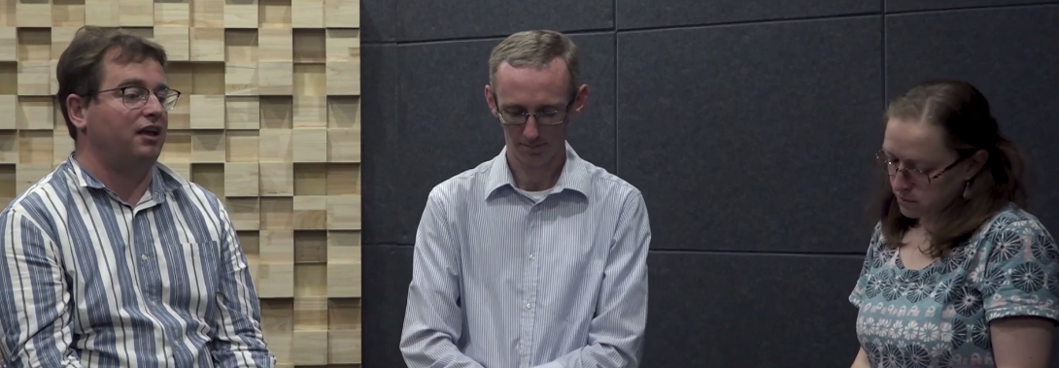
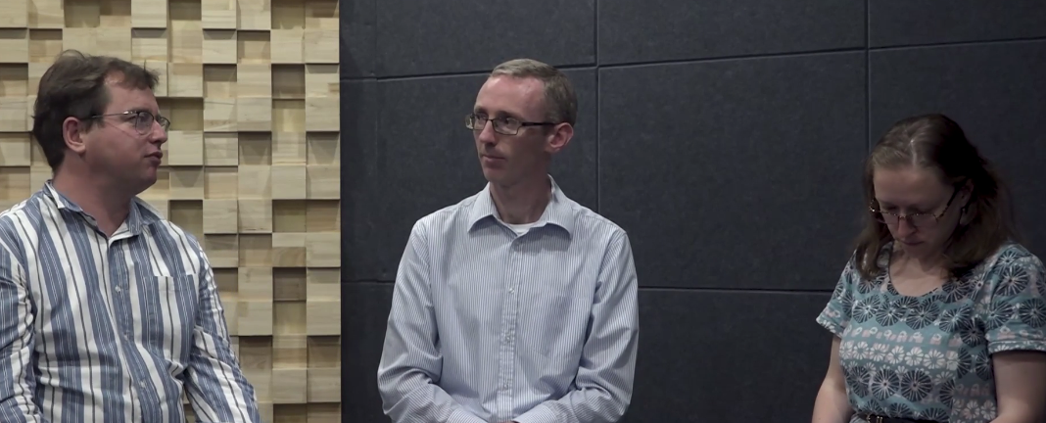
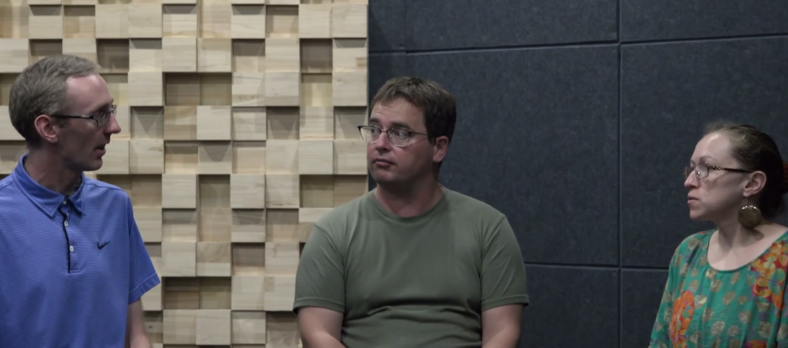
Language and skills focus: Interaction - review
You are going to watch three short Group Discussion extracts. As you watch, focus on each speaker’s interaction and make notes in your OCSa Workbook (Lesson 10.2).
After each video, discuss whether the score for each speaker is closer to a high pass, a low pass or a fail. Justify your choice.
Video 1
Video 2
Video 3
John
Robert
Michaela
John
Robert
Michaela
Robert
John
Michaela

Slide 14
Language and skills focus: Interaction - review
Video 1
 | Score | Justification
John
Robert
Michaela
Fail
Speaking turn is way too long and does not give the others a chance to speak (i.e. dominant).
Uses an impolite hand gesture.
Low pass
Interacts well with Michaela.
Body language is not inclusive of all group members (i.e. little eye contact with John; turns his back on John).
Uses an impolite hand gesture.
Low pass
Interacts well with Robert.
Often not engaged (e.g. looking at the ceiling or notes).
Eye contact is not inclusive of all group members (i.e. little eye contact with John).
John
Robert
Michaela

Slide 15
Language and skills focus: Interaction - review
 | Score | Justification
John
Robert
Michaela
Video 2
Fail
They encourage each other to give their opinions.
They attempt to demonstrate collaborative behaviour by ‘agreeing’ with each other. However, they don’t build on each other’s ideas.
There is no evidence that they have listened to each other and understood the points the others are making.
Overall, they’re not actually interacting with each other.
Fail
Fail
John
Robert
Michaela

Slide 16
Language and skills focus: Interaction - review
 | Score | Justification
Robert
John
Michaela
Video 3
High pass
They build on each other’s contributions to develop an idea.
Good turn-taking - good balance between listening and speaking.
Effective use of body language to show they’re listening to each other (e.g. eye contact, nodding).
Overall, it is an interactive discussion.
High pass
High pass
Robert
John
Michaela

Slide 17

Discussion focus

Slide 18
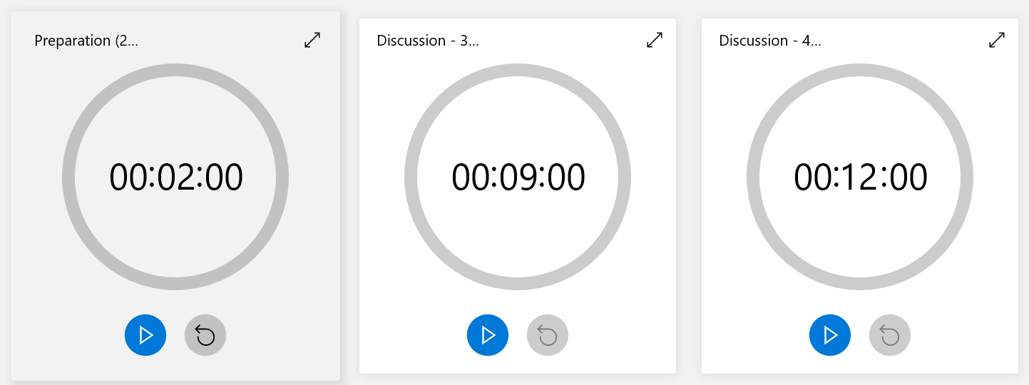
Discussion focus: Discuss
In your group, have a discussion based on the prompt below.
You have 2 min to prepare.
Then, you will complete the group discussion.
Agree on 2-3 issues that may affect the development of AI in the future.
Rank them starting with the most significant.
This prompt is similar to the final Group Discussion Exam.

Slide 19
Discussion focus: Reflect
Reflect on your group discussion in terms of your interaction. Try to consider what you did well as well as what you need to improve.
 |  | Yes | Maybe | No
My group | We used appropriate turn-taking.
 | Everyone spoke for an appropriate length of time.
 | We encouraged each other to contribute.
 | We used body language effectively.
One thing that my group did particularly well was …
One thing that we could improve in the future is …
Would you give yourself a rating of high pass / low pass / fail for interaction?

Slide 20
Homework
Due | Task
Lesson 11.1 | Review your lecture notes for Core Units 1-6 (Lectures A and B). Bring them to class.

Slide 21

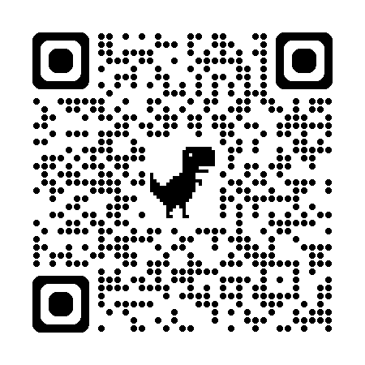
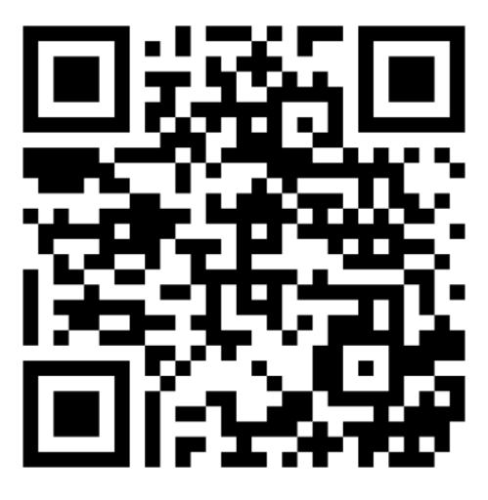
Week 10
Extra resources for OCSa this week on the Writing Lab Moodle page:
Speaking → University speaking tasks (group discussions)
Next week (Week 11 – beginning the 9th of December):
Utalk continues!
Monday, Tuesday, Thursday, Friday = PB 115 1:00 – 1:50pm
Wednesday = PB 201 1:00 – 1:40pm
Evening sessions available (check SPDPO system for times)
NEW!
Extra group discussion practice (with feedback)
Sign up via the Writing Lab Friday email.
Centre for English Language Education CELE N048 AY 24-25

